Slide 1
7/28/2022
Governor's Office of Science, Innovation and Technology (OSIT): High Speed NV Initiative Project – Phase 1
For
Nye County Facilities
1
Target State Facilities within Nye County to Upgrade to High-Speed Internet
ID | Name of Facility | ID Type | ID_name | Full Address | Address | City
CC020 | Tonopah Conservation Camp | CC | Corrections | 100 Conservation Rd, Tonopah, NV 89049 | 100 Conservation Rd | Tonopah
CT012 | Esmeralda and Nye County District Court | CT | Courts | 1520 East Basin Avenue, Suite #105, Pahrump, NV 89060 | 1520 East Basin Avenue, Suite #105 | Pahrump
CT020 | Nye County Clerk's Northern | CT | Courts | 101 Radar Road, Tonopah, NV 89049 | 101 Radar Road | Tonopah
CT029 | Beatty Township Justice Court | CT | Courts | 426 C Avenue South, Beatty, NV 89409 | 426 C Avenue South | Beatty
IT012 | Forestry | IT | EITS | 100 Conservation Road State Route 376, Tonopah, NV 89409 | 100 Conservation Road State Route 376 | Tonopah
NT001 | Beatty Maintenance Station | NT | NDOT | 350 US-95, Beatty, NV 89003 | 350 US-95 | Beatty
NT002 | Big Smokey Maintenance Station | NT | NDOT | SR 376 NY MP 53.36 |  | Smoky Valley
NT003 | Blue Jay Maintenance Station | NT | NDOT | US 6 NY MP 65.80
NT027 | Tonopah Maintenance Station | NT | NDOT | 805 Erie Main St. Tonopah, NV | 805 Erie Main St. | Tonopah
NT043 | Old Current Creek Maintenance Station | NT | NDOT |  |  | Currant Creek
NW007 | Kirch Wildlife Management Area | NW | NDOW | Hwy 318 32 M S Of Lund, Lund, NV | Hwy 318 32 M S Of Lund | Lund
NW011 | Office - Law Enforcement, Biologists, Hunt Check-i | NW | NDOW | 400 Howerton Hill, Tonopah, NV 89049 | 400 Howerton Hill | Tonopah
SL007 | Duckwater Shoshone Elementary School | SL | Schools & Libraries | 509 Rd Duckwater Falls, Duckwater, NV 89314 | 509 Rd Duckwater Falls | Duckwater
SL049 | Round Mountain Library | SL | Schools & Libraries | 73 Hadley Cir, Round Mountain, NV 89045 | 73 Hadley Cir | Round Mountain
SL050 | Manhattan Library | SL | Schools & Libraries | 7 Mineral Street School House Gold St, Manhattan, NV 89022 | 7 Mineral Street School House Gold St | Manhattan
SL051 | Gabbs Community Library | SL | Schools & Libraries | 602 3rd St, Gabbs, NV 89409 | 602 3rd St | Gabbs
UN014 | Coop Extension - Northern Nye / Esmeralda Count | UN | Coop-Extension | #1 Frankie St Old Courthouse, Tonopah, NV 89049-0231 | #1 Frankie St Old Courthouse | Tonopah
UN018 | Coop Extension - Southern Nye County | UN | Coop-Extension | 1651 E Calvada Blvd, Pahrump, NV 89048 | 1651 E Calvada Blvd | Pahrump
Legend for all maps in Briefing
2

Slide 2
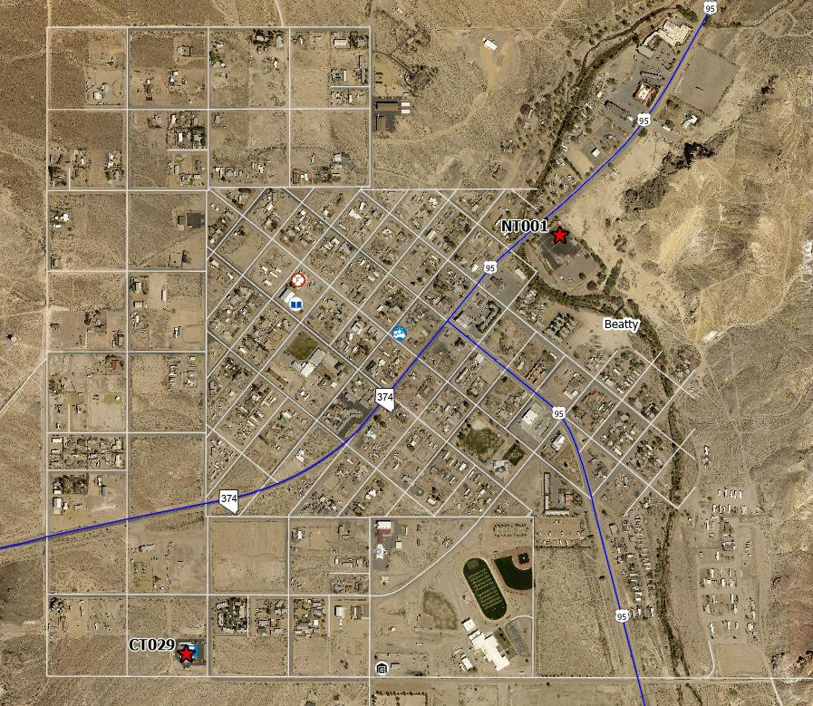
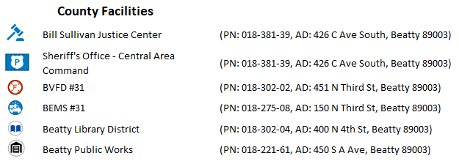
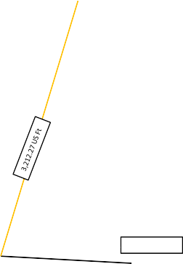
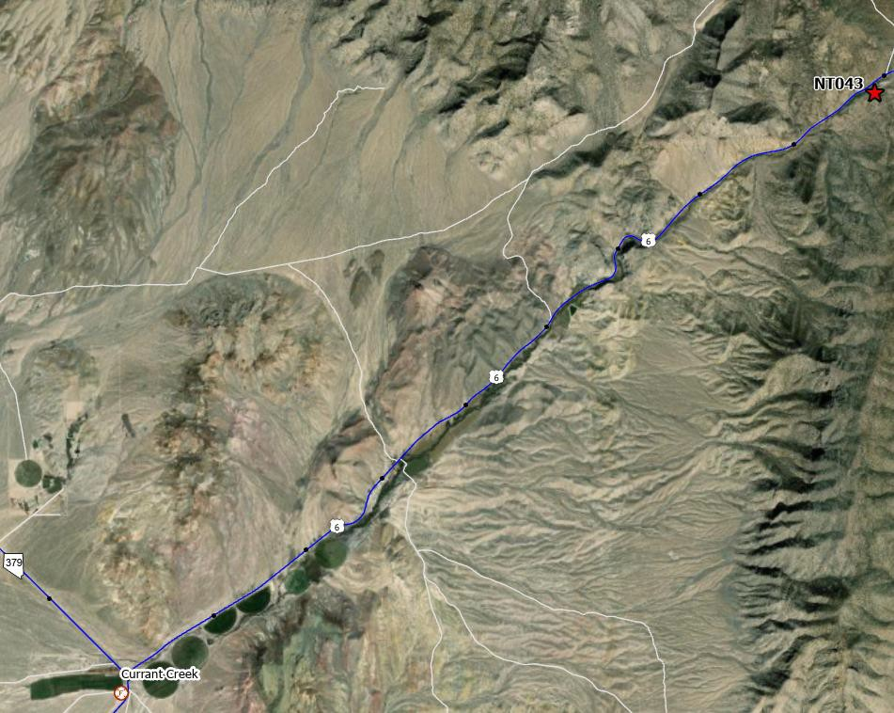
Beatty -- State and County Facilities
7/28/2022
NT001 -- Beatty Maintenance Station
CT029 -- Beatty Township Justice Court
Bill Sullivan Justice Center Sheriff's Office – Central Area Command
1,594.27 US Ft
4
Currant Creek -- State and County Facilities
NT043 -- Old Current Creek Maintenance Station
5

Slide 3
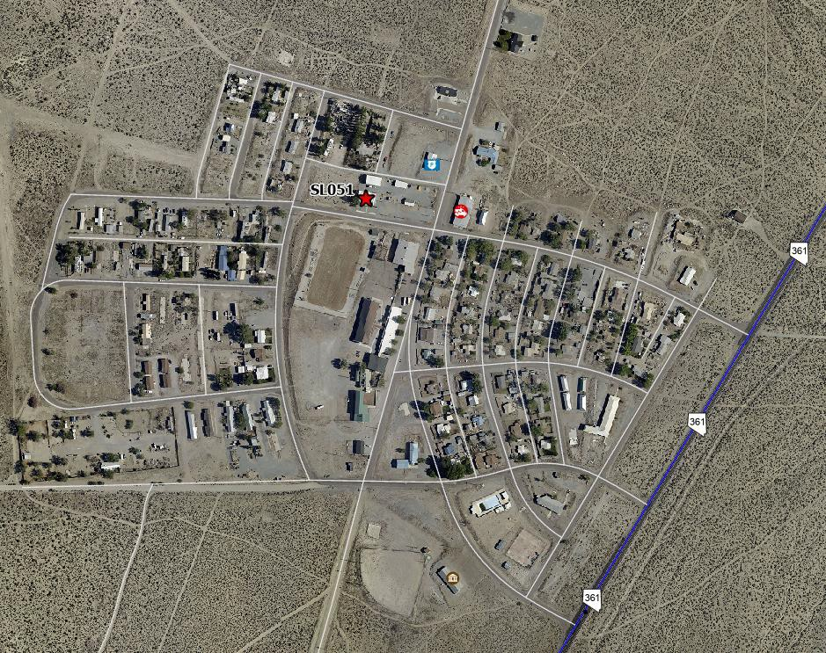
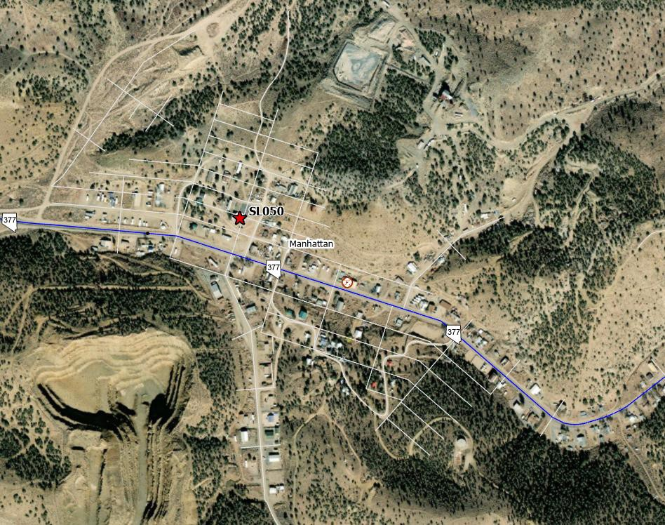
South Gabbs -- State and County Facilities
7/28/2022
Gabbs Library
277.83 US Ft
SL051 -- Gabbs Community Library
369.48 US Ft
7
Manhattan -- State and County Facilities
SL050 -- Manhattan Library
Manhattan Library
801.91 US Ft
8

Slide 4
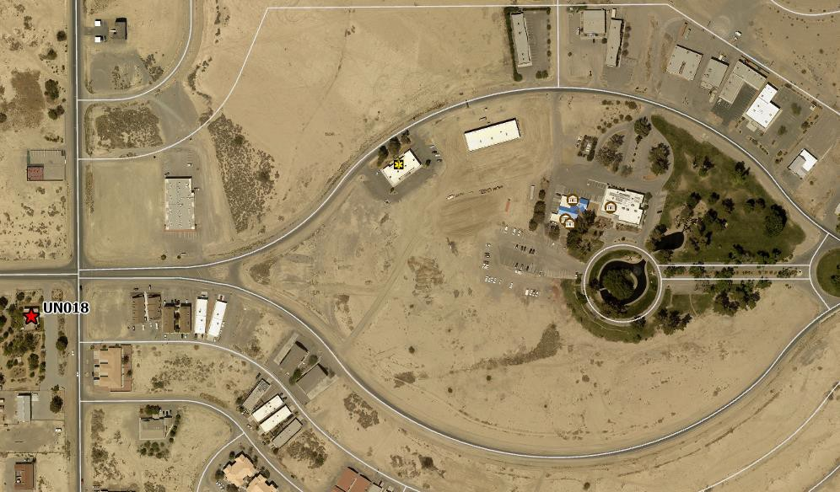
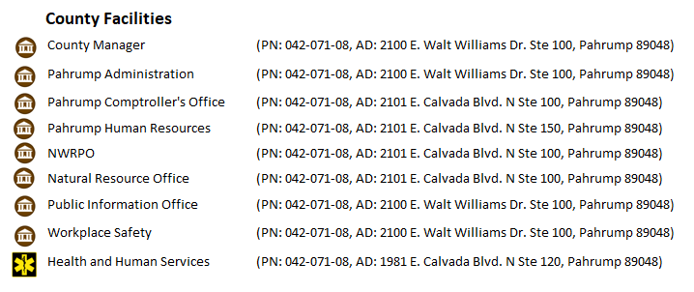
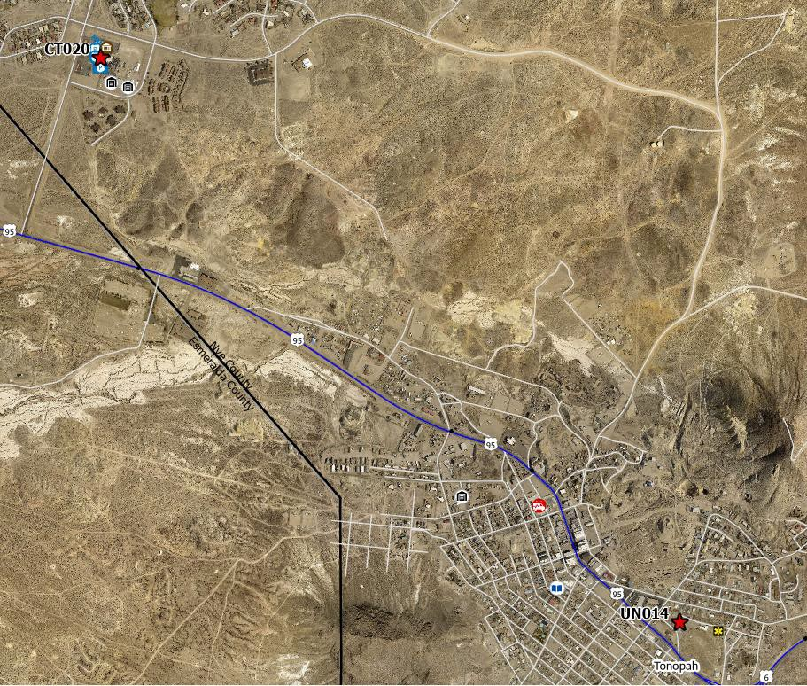
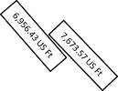
7/28/2022
Pahrump “The Eye” -- State and County Facilities
UN018 -- Coop Extension - Southern Nye County
12
Tonopah Southern Facilities -- State and County Facilities
UN014 -- Coop Extension - Northern Nye / Esmeralda County
CT020 -- Nye County Clerk's Northern
2,424.72 US Ft
3,036.38 US Ft
16

Slide 5
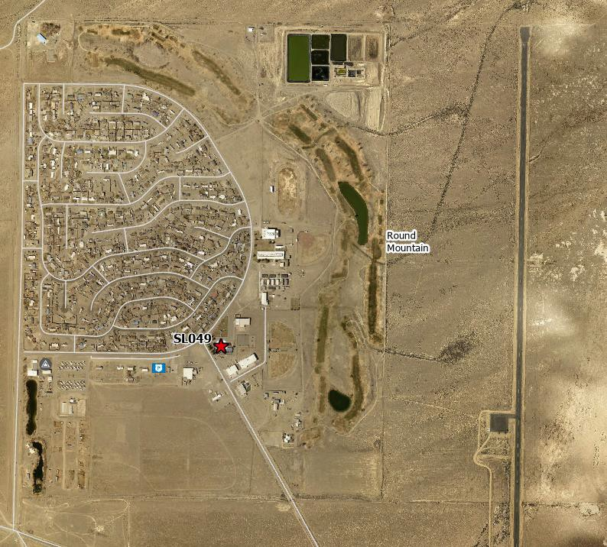
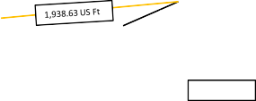
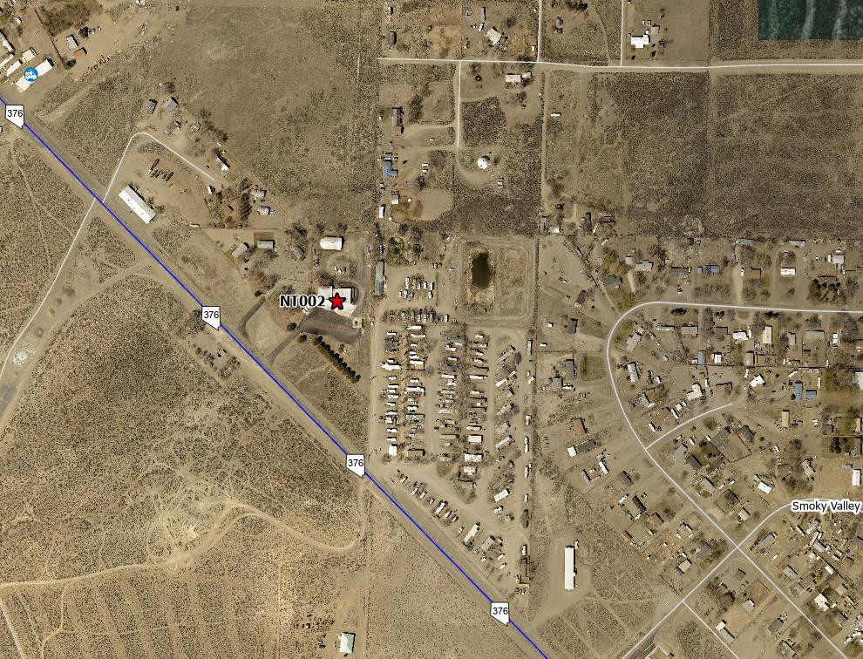
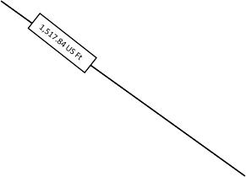
7/28/2022
Round Mountain / Hadley-- State and County Facilities
SL049 = Round Mountain Library
Round Mountain Library
Northern Hazmat Team RMVFD #21
725.72 US Ft
17
Carvers / Smoky Valley -- State and County Facilities
NT002 = Big Smokey Maintenance Station
18

